Slide 1

Security Analysis of the
Internet Architecture
Master Thesis - Marco Seewer
Supervised by Roland Meier, Jordi Nieto, and Adrian Perrig
This research is supported by armasuisse Science and Technology.

Slide 2


No control
No isolation
Poor scalability
Notes:
1. no control over path (and only 1 path)
2. bogus AS (network) can announce IP prefixes and attract world-wide traffic (as happened in AS 7007 incident, or 3 years back: Facebook)
3. New route / AS → new routes (info disseminated to entire internet) + convergence can take multiple minutes

Slide 3
Scalability, Control, and Isolation on Next-Generation
Networks
Developed at ETH Zurich
Open-Source
Commercialized by Anapaya

Slide 4
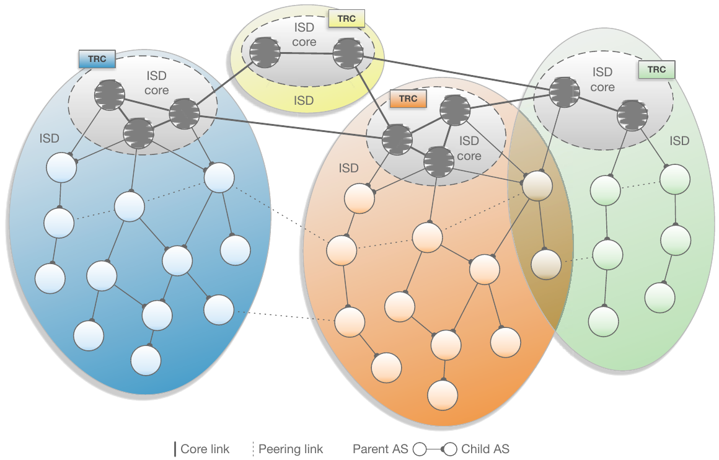
Isolation domain (ISD):
Isolate routing within ISD
Scalability: separate routing within / between ISD
ISD Core:
Root of trust
Init path construction
The Complete Guide to SCION, Figure 2.1
Notes:
ISD: country
Isolate (no global kill switch→ BGP prefix hijack)

Slide 5
SCION
Forwarding: Packet header
Path control
SCION
Notes:
Scales (no state at routers)

Slide 6


SWITCH
AS: 559
CYD Testbed:
3 ASes
3 Core ASes
  SCION Production Network
Anapaya Routers
  Different HW / SW
  Configurations
Swisscom
AS: 3303
Sunrise
AS: 6730
Zurich AS:
2:0:2b
Thun AS:
2:0:2c
Lausanne AS:
2:0:2d
Notes:
Anapaya SW:
- own BR + Gateway

Slide 7
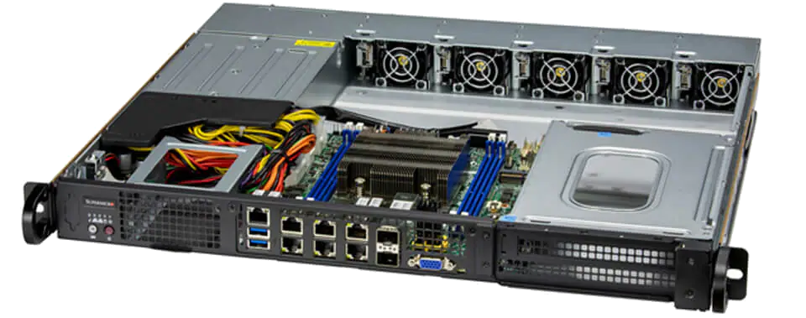
Anapaya Device – Router
Automated scans
  Unauthenticated + authenticated vulnerability scans
  Compliance scans
  Docker images
Manual investigation
  Scan results applicable
  (Threat model: Outside attacker)
  Open ports + running services
  SCION configuration (Appliance)
https://www.supermicro.com/files_SYS/images/System/SYS-110D-8C-FRAN8TP_main.jpg
Notes:
Operational devices

Slide 8
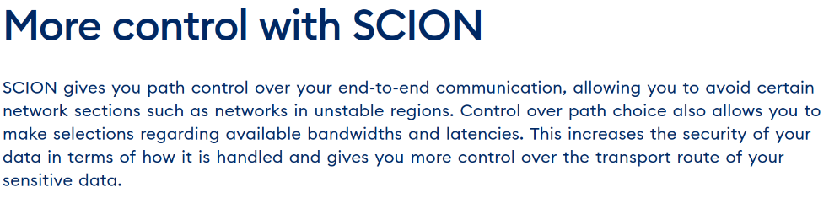
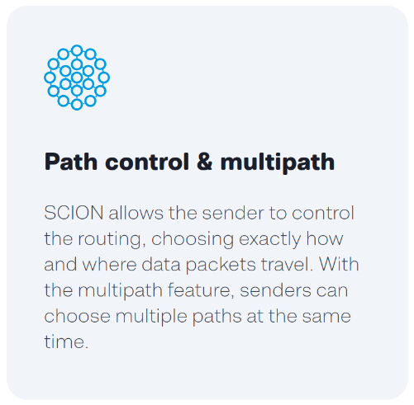
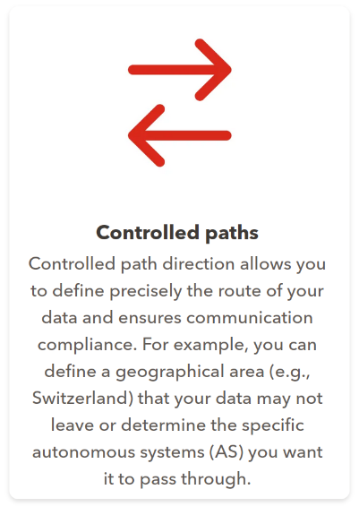
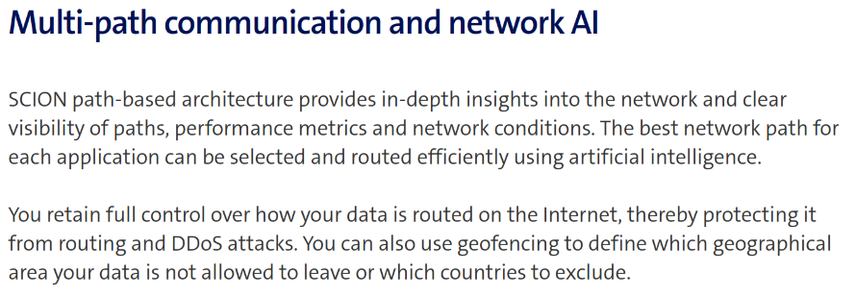
https://www.switch.ch/en/network/scion-access
https://www.anapaya.net/scion-internet
https://www.sunrise.ch/business/en/enterprise/internet-networking/business-wan/scion
https://www.swisscom.ch/en/business/enterprise/offer/wireline/scion.html

Slide 9
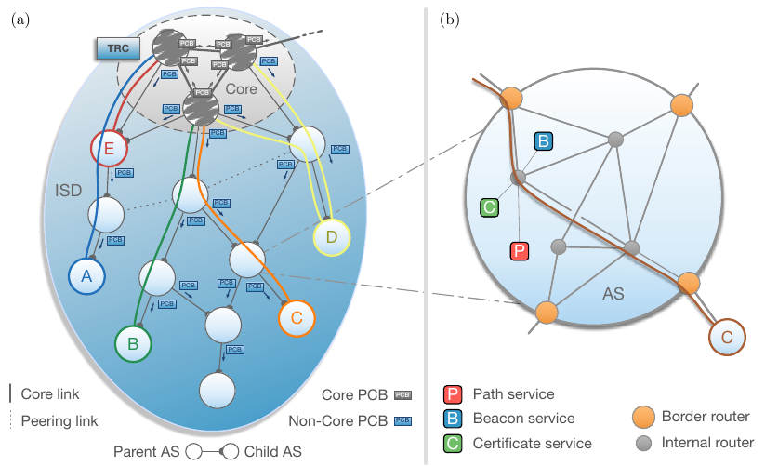

SCION Protocol – Path exploration
Initiated from core
Save ingress/egress interfaces
Each hop is signed (=MAC of whole path)
MAC algorithm
=
Open-Source (CMAC)
=
Secure!
The Complete Guide to SCION, Figure 2.3
Notes:
CMAC = AES 128 + additional shifts
Check MAC == open source

Slide 10
AS:12350
SWITCH
AS: 559
AS:15623
Combine hops of different paths
(path splicing)
Swisscom
AS: 3303
Sunrise
AS: 6730
Zurich AS:
2:0:2b
Thun AS:
2:0:2c
Lausanne AS:
2:0:2d
Notes:
Not working → MAC check

Slide 11

Modify path in header
Revert on response
SCION
Notes:
Resultat weg

Slide 12
Path manipulation – Preventions
Packet authentication (SCION)
End hosts:
  Own MAC
  Path comparison once TLS session is established
Notes:
== source authentication

Slide 13
SWITCH
AS: 559
Source Address Spoofing
DDoS reflection attacks
(amplification)
Swisscom
AS: 3303
Sunrise
AS: 6730
Zurich AS:
2:0:2b
SRC: 2:0:2c
DST: 2:0:2d
Thun AS:
2:0:2c
SRC: 2:0:2d
DST: 2:0:2c
Lausanne AS:
2:0:2d
Notes:
Nur test setup keine resultate

Slide 14
SWITCH
AS: 559
Volumetric DoS
1. “Normal” Internet → Impact on SCION
2. SCION traffic → Robustness
SCION user outside of CYD
1. Impact (e.g. error message)
2. Packet sniffing
40 Gbps
10 Gbps
ETH
CYD
Notes:
Nur test setup keine resultate

